Slide 1

Involvement of Little Hands Organisation in disaster management and relief efforts

Slide 2
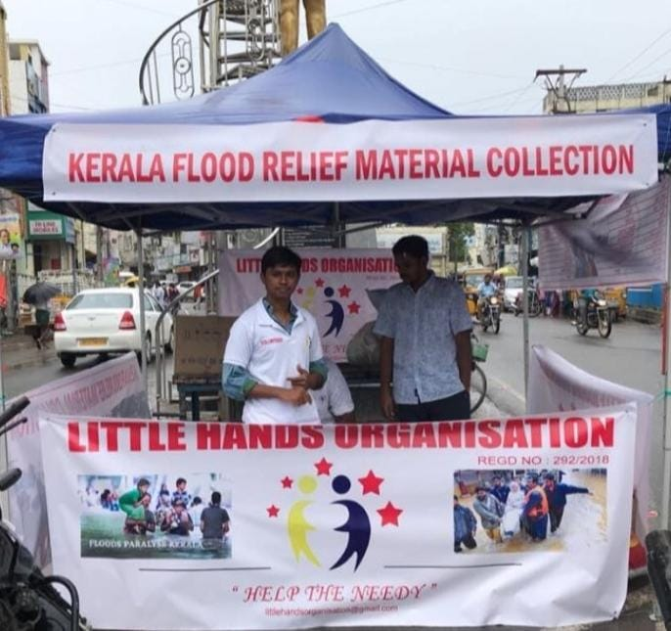
Kerala Flood Relief
The Kerala floods of 2018 were one of the worst in Kerala’s history and affected almost all the state’s 14 districts. These floods destroyed infrastructure such as roads, bridges, and homes. Over 400 people lost their lives and thousands were injured.

Slide 3
Little hands organisation has made the decision to assist individuals in Kerala
What have we done?
1
Organised flood relief material donation camps on multiple days
2
Collected funds from people
3
Packed the material and dispatched to the relief camps

Slide 4

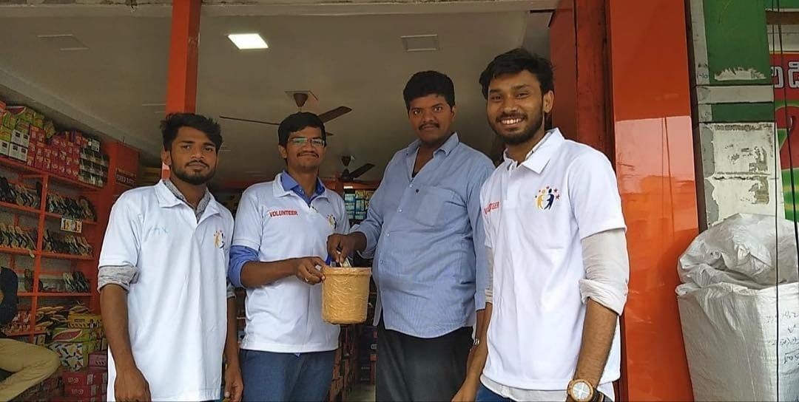
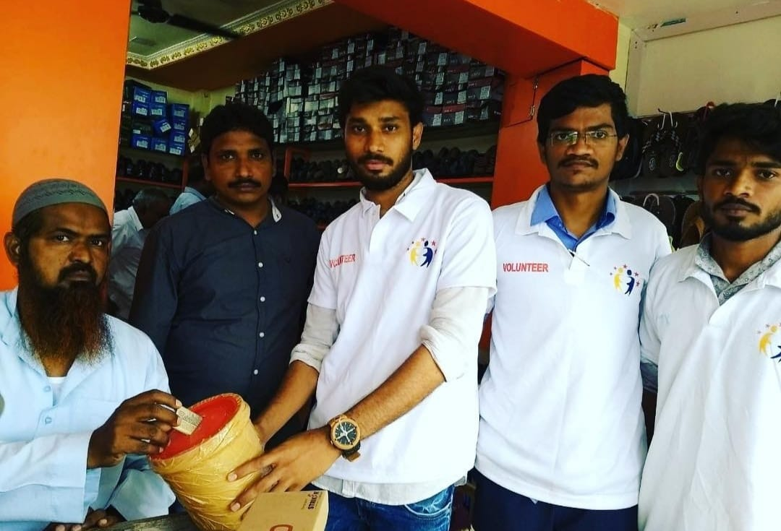
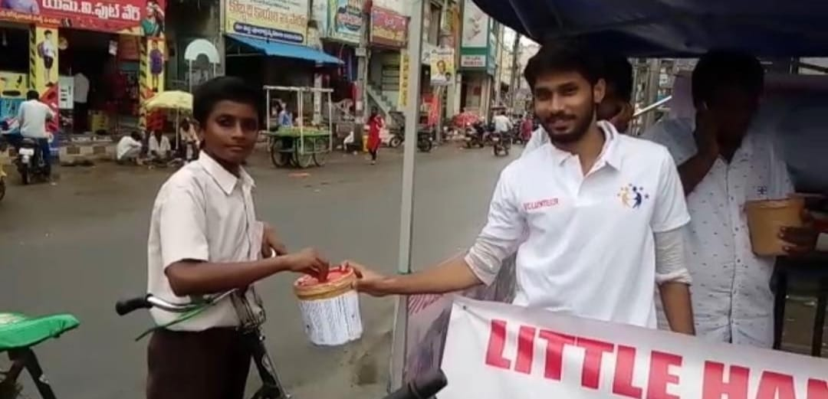
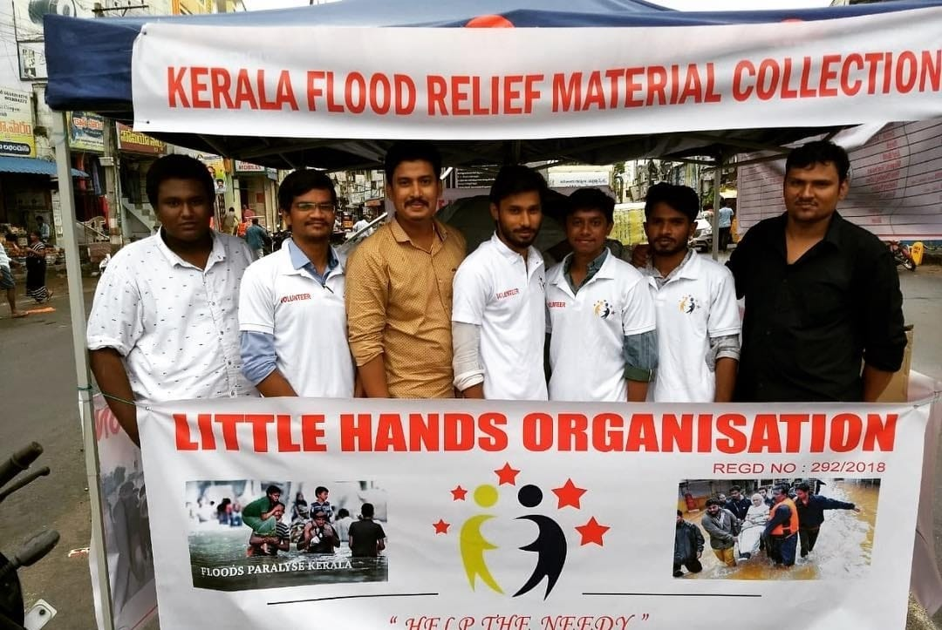
Day-1 of Kerala flood relief material collection

Slide 5



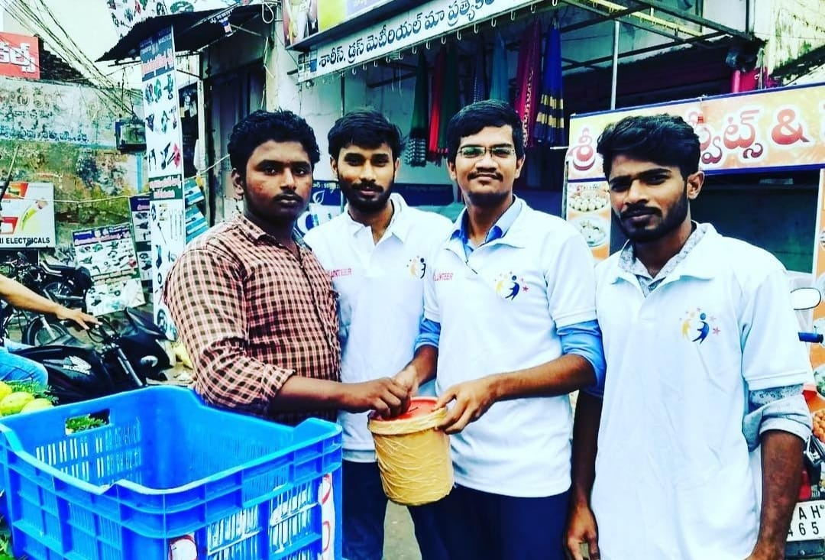
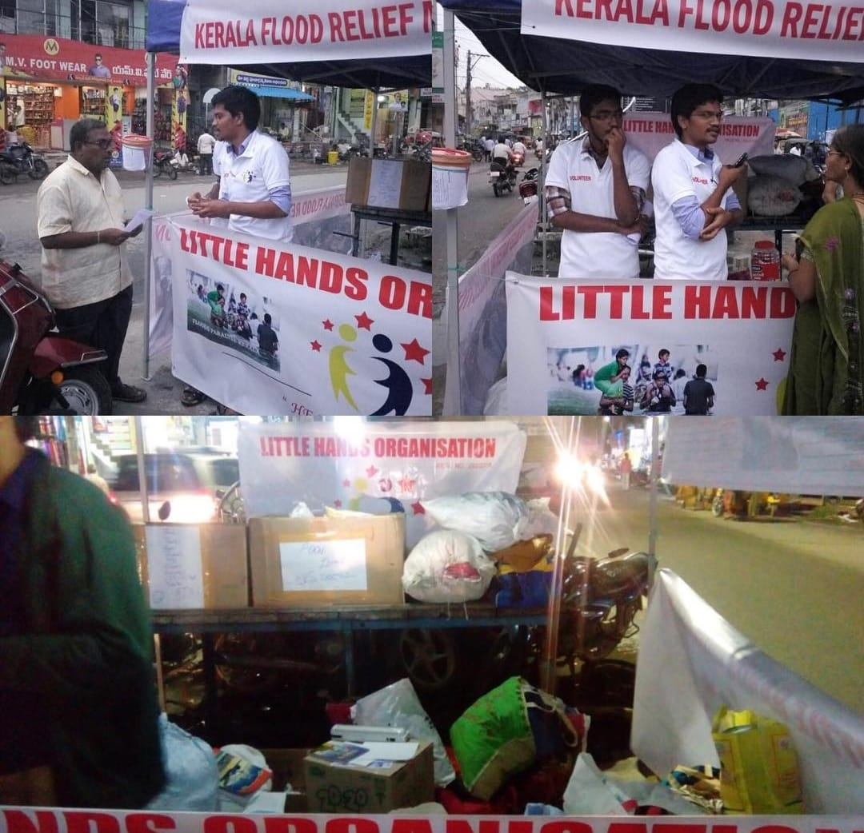

Day-1 of Kerala flood relief material collection

Slide 6

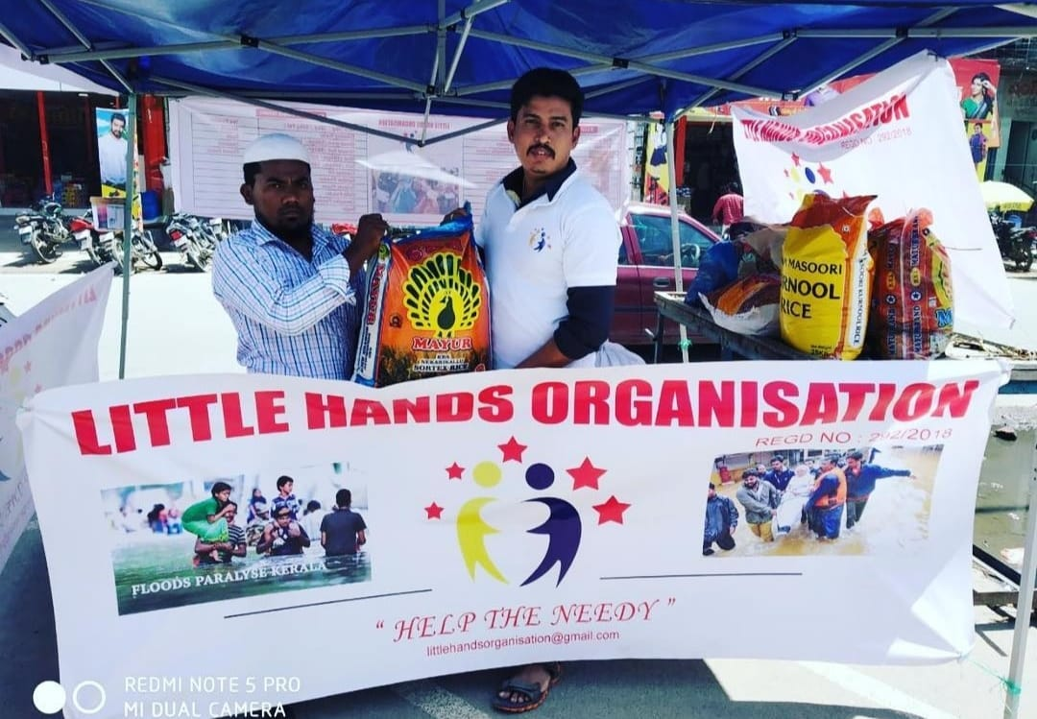
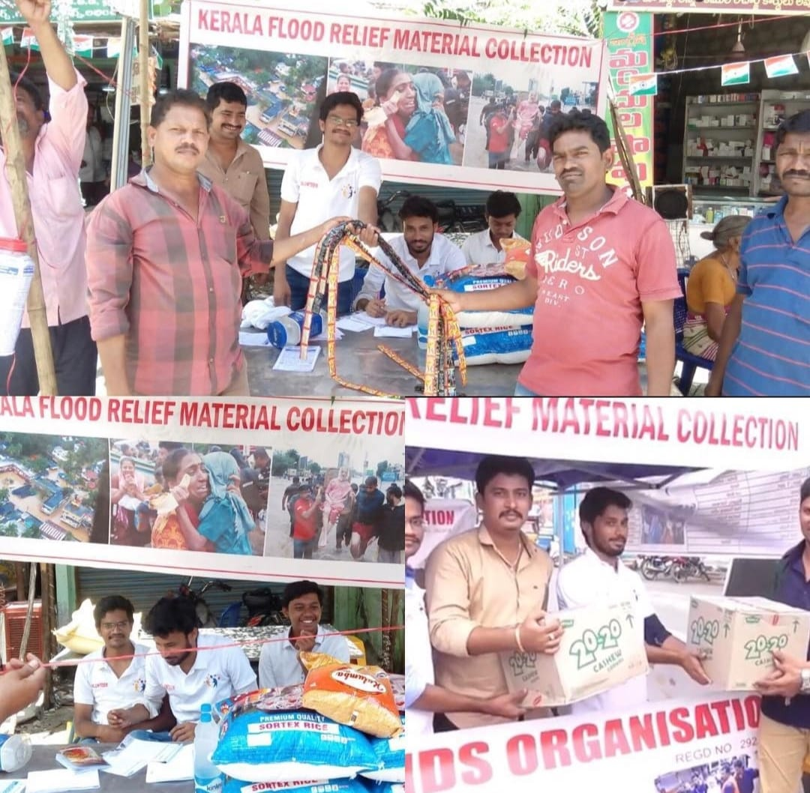
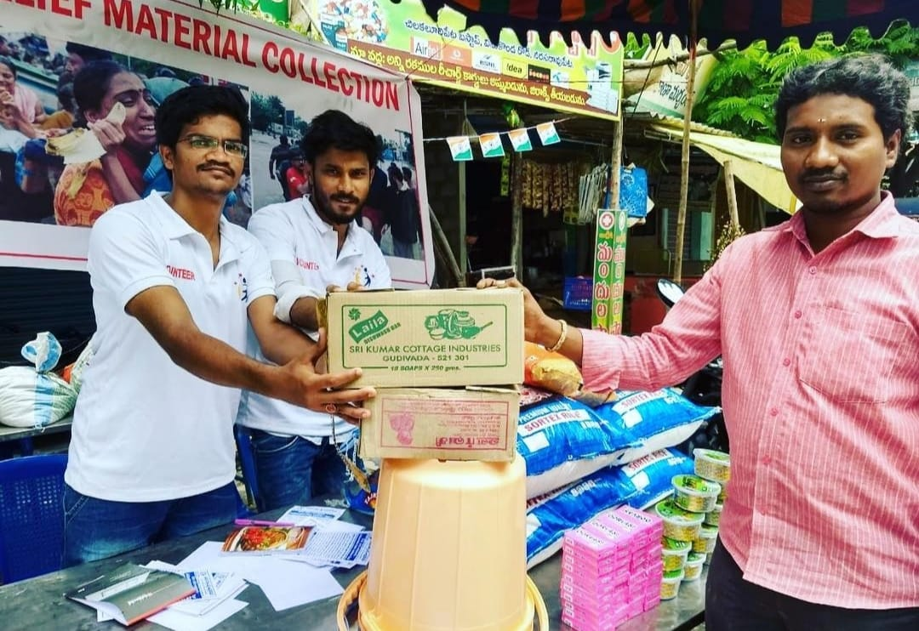
Day-2 of Kerala flood relief material collection

Slide 7
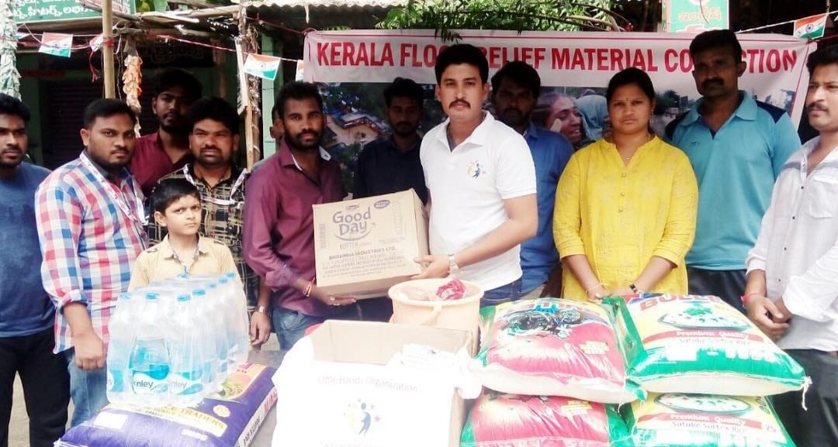

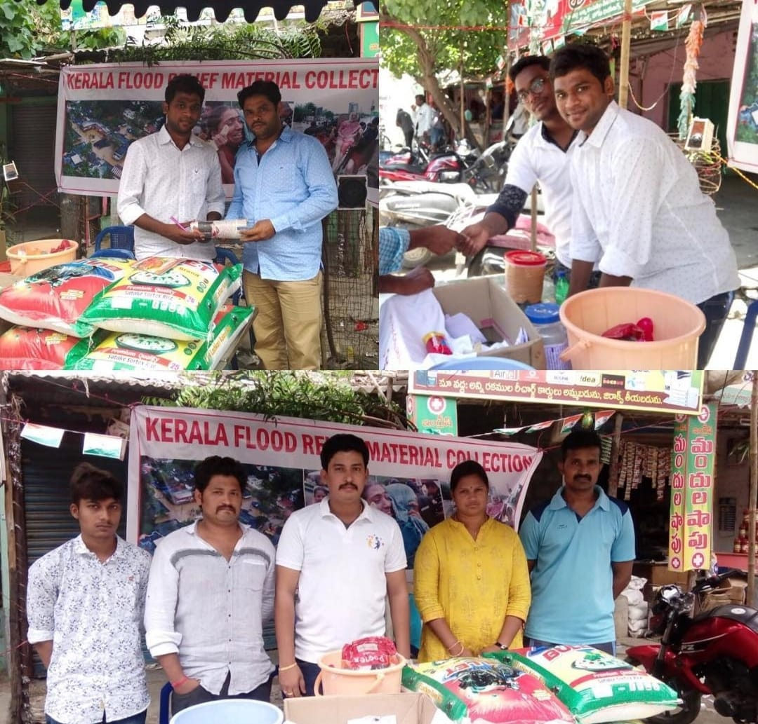
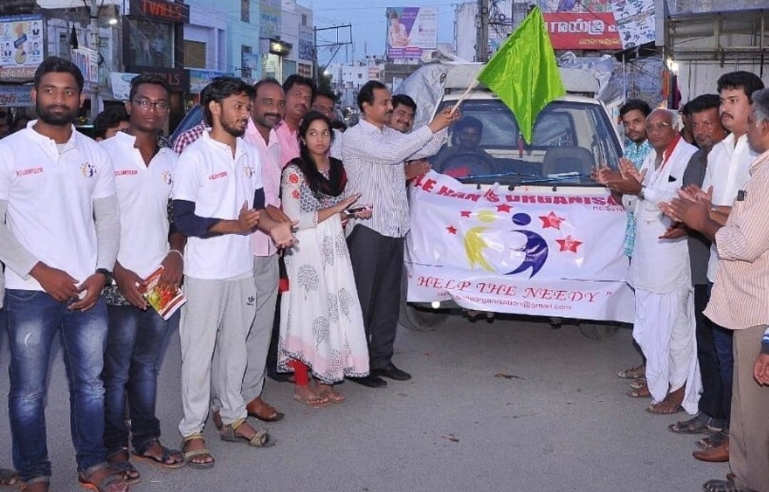
Day-3 of Kerala flood relief material collection

Slide 8
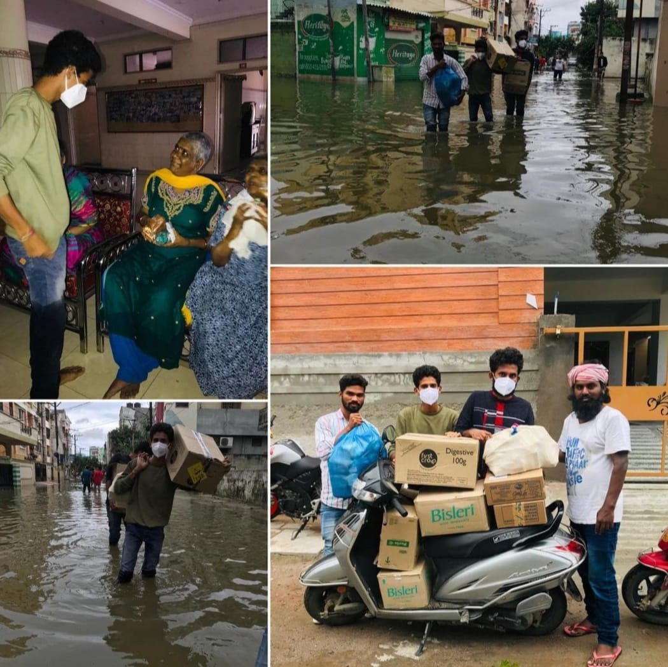
Hyderabad Flood Relief
The Hyderabad floods of 2020 were a severe natural disaster that caused widespread damage and loss of life in the city. The flooding resulted in the loss of over 50 lives, the displacement of thousands of people, and extensive damage to homes, businesses, and infrastructure.

Slide 9

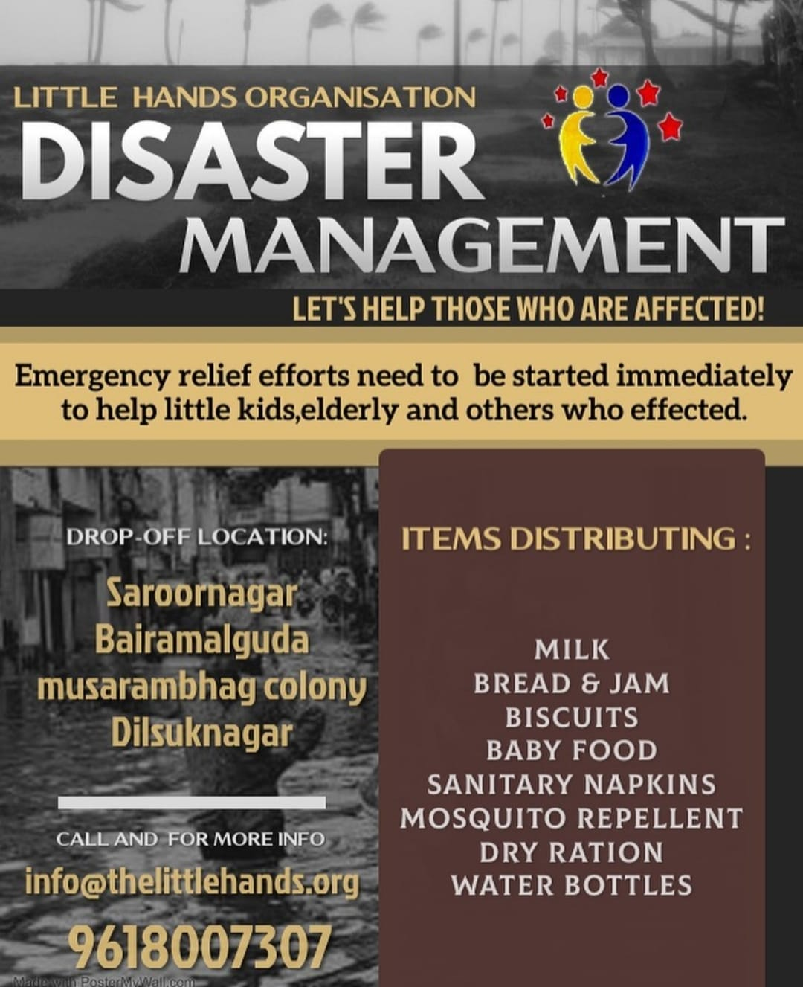
The unannounced and continuous heavy rains have damaged lives and properties in many areas across the city. Little Hands Organisation formed a group to assist those who were affected, particularly the elderly, children, and others.
What have we done?
Volunteers provided aid by distributing food and water to those who suffered from the floods.
We rendered assistance to residents in various areas such as Bairamalguda, Saroornagar, Raghavendra Nagar Colony, Greenpark Colony, Chadarghat, Musarambagh Colony, Singareni Colony Slum, RN Reddy Nagar Slum, and Osmangunj.

Slide 10

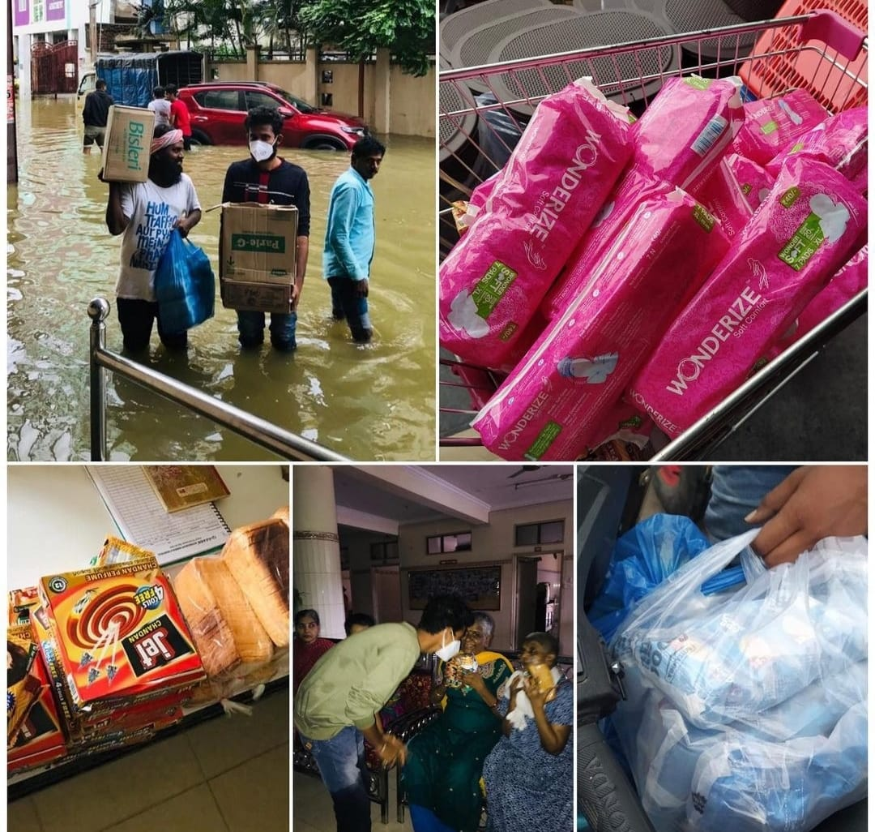
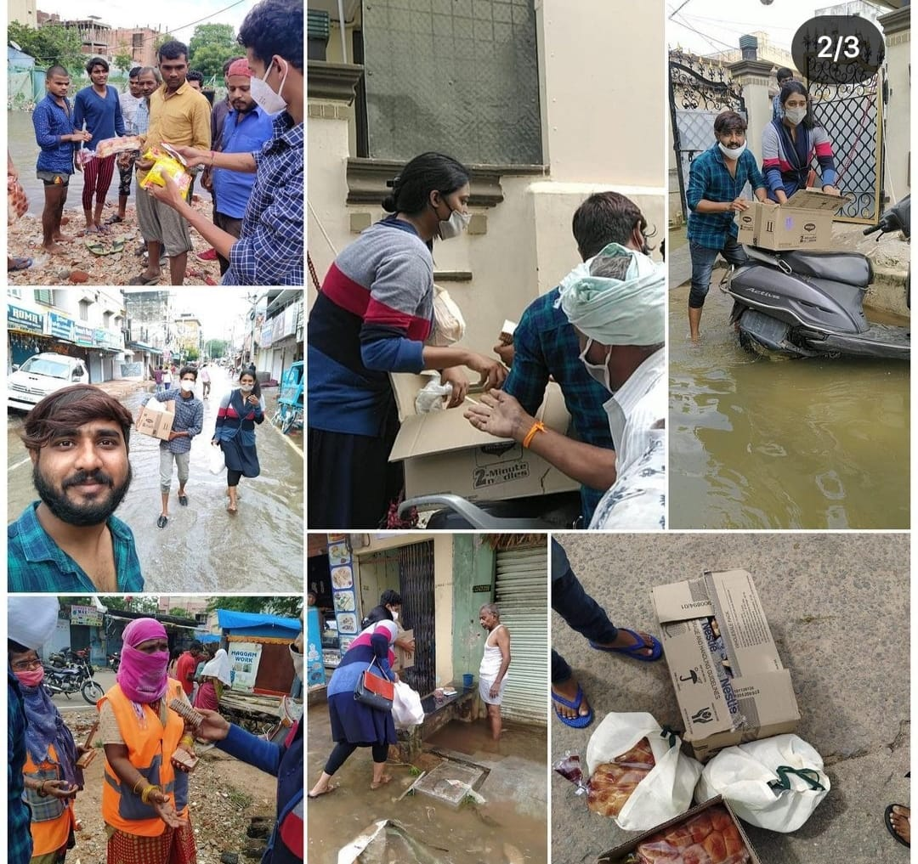
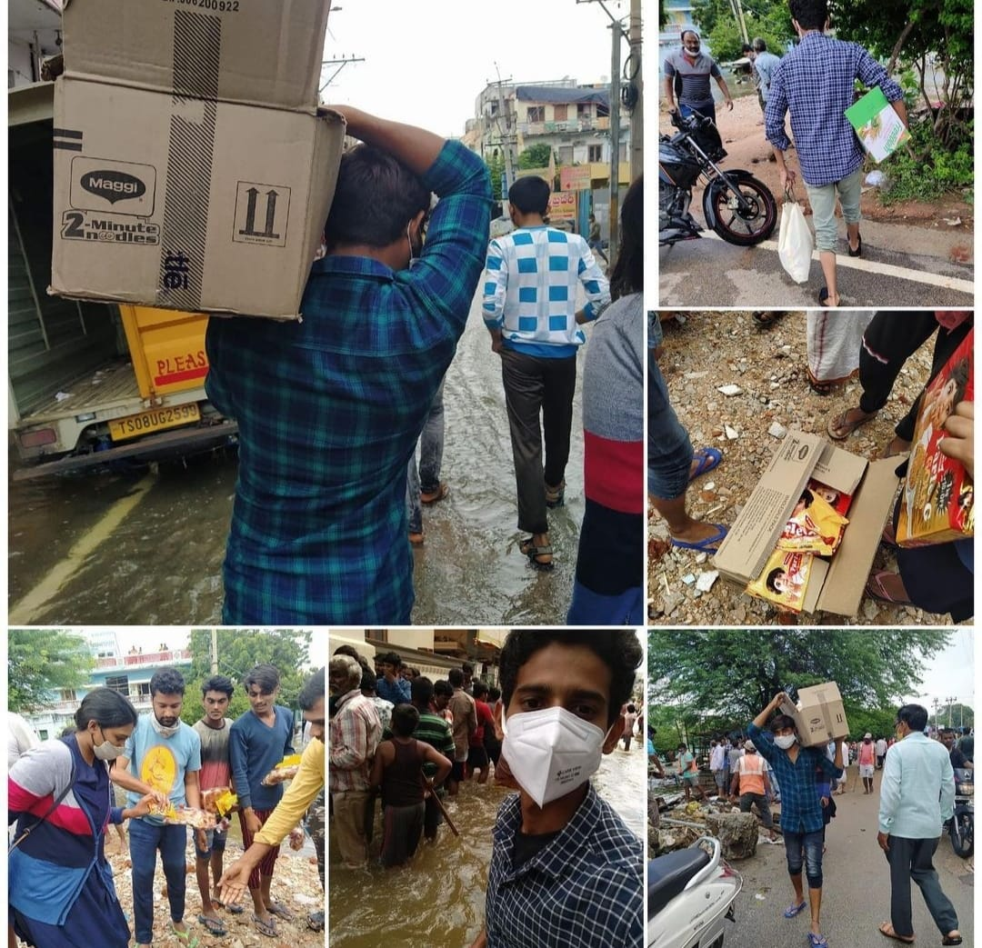


Hyderabad Flood Relief

Slide 11


